Slide 1

Analysing Student Mental Health: A Comprehensive Guide
Presenter: Pranav Nandeshwar

Slide 2

Content
Section 1: Demographic Analysis
Section 2: Mental Health Analysis
Section 3: Academic Performance and Activities

Slide 3

Section 1
Demographic Analysis

Slide 4

Gender Distribution
Gender Distribution and Age
Average Age and Age Distribution by Gender
Understanding the count of students grouped by gender provides insights into the demographic composition of the dataset.
Exploring the average age and age distribution by gender sheds light on the age demographics of the student population.

Slide 5

Section 2
Mental Health Analysis

Slide 6
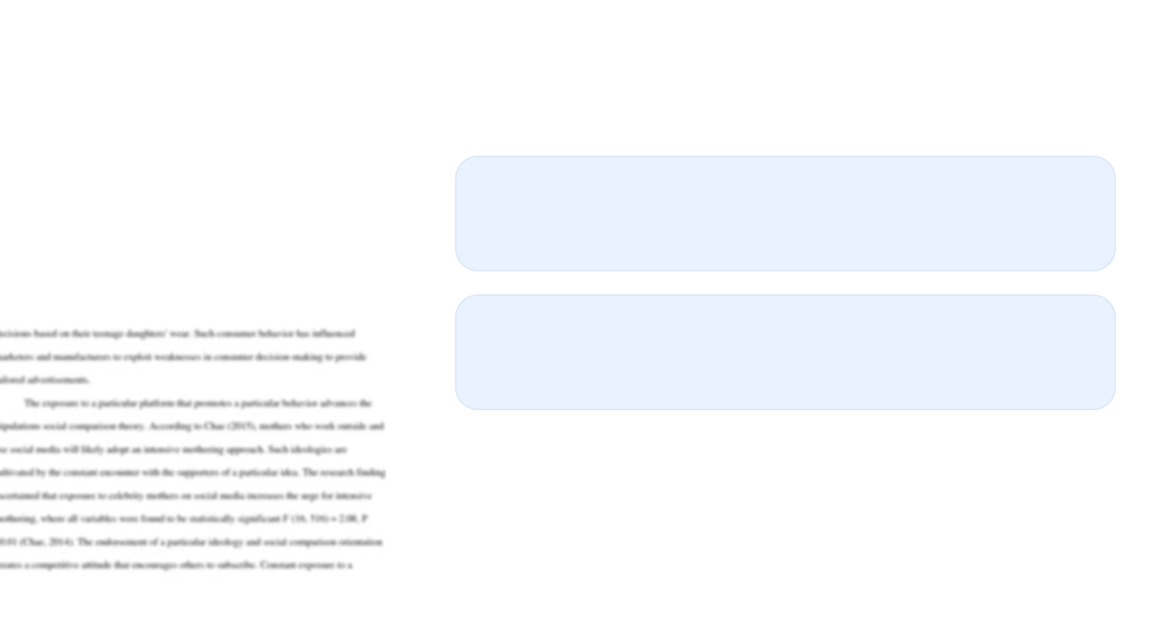
Social Comparison and Personal Perception
Perceptions of Friends' Prospects
Understanding how students perceive their friends' prospects offers insights into social comparison and its impact on mental health.
Creativity, Intelligence, and Self-Worth
Exploring students' perceptions of their creativity, intelligence, and self-worth provides valuable insights into personal perception and its relationship to mental well-being.

Slide 7

Advanced Analysis
01
02
Cluster Analysis
Regression Analysis
Identifying different student mental health profiles through cluster analysis offers a nuanced understanding of mental health patterns.
Identifying predictors of the depression index through regression analysis provides valuable insights into the factors influencing mental well-being.

Slide 8

Additional Queries
Average Screen Time by Gender
High Confidence Levels
Understanding the average screen time by gender sheds light on technology usage patterns and their potential impact on mental health.
Exploring the number of students reporting high confidence levels offers insights into self-perception and mental well-being.

Slide 9

Conclusion
01
02
Impact of Social Connection
Financial Situation and Mood/Outlook
Understanding the impact of social connection on the depression index provides valuable insights into the role of social relationships in mental health.
Exploring the relationship between financial situation and mood/outlook on life sheds light on the intersection of financial well-being and mental health.

Slide 10

Thank You
Contact: pranav.Nandeshwar@outlook.com

